Slide 1
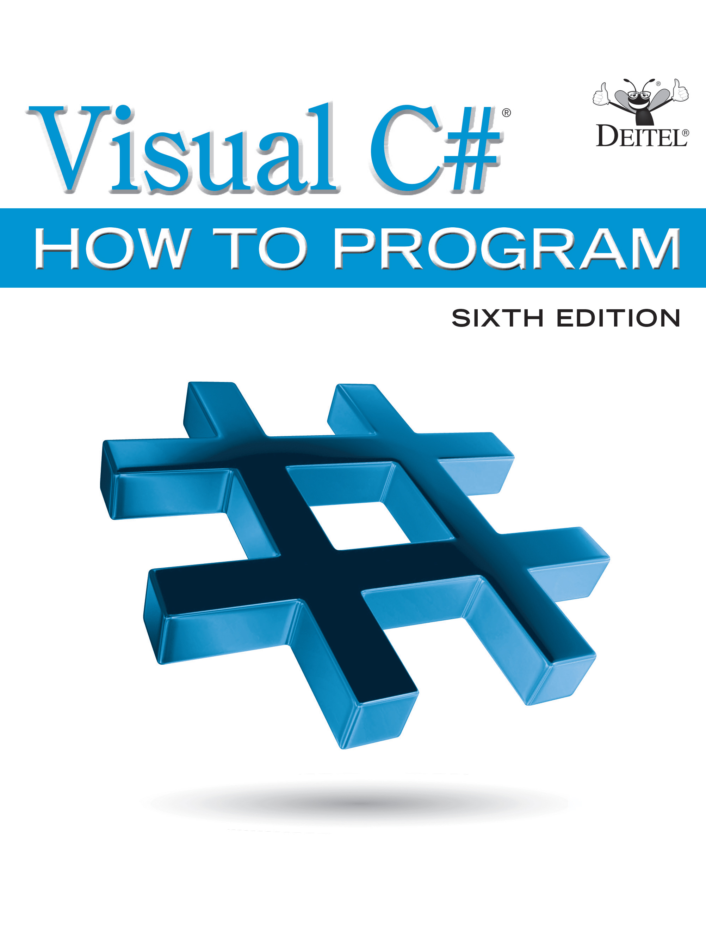
Visual C sharp® How to Program
Sixth Edition
Chapter 17
Files and Streams
Copyright © 2017 Pearson Education, Inc. All Rights Reserved
Notes:
If this PowerPoint presentation contains mathematical equations, you may need to check that your computer has the following installed:
1) MathType Plugin
2) Math Player (free versions available)
3) NVDA Reader (free versions available)

Slide 2
Learning Objectives
Create, read, write and update files
Use classes File and Directory to obtain information about files and directories on your computer.
Use L I N Q to search through directories.
Become familiar with sequential-access file processing.
Use classes FileStream, StreamReader and StreamWriter to read text from and write text to files.
Use classes FileStream and BinaryFormatter to read objects from and write objects to files.

Slide 3
Outline (1 of 2)
17.1 Introduction
17.2 Files and Streams
17.3 Creating a Sequential-Access Text File
17.4 Reading Data from a Sequential- Access Text File
17.5 Case Study: Credit-Inquiry Program
17.6 Serialization

Slide 4
Outline (2 of 2)
17.7 Creating a Sequential-Access File Using Object Serialization
17.8 Reading and Deserializing Data from a Binary File
17.9 Classes File and Directory
17.9.1 Demonstrating Classes File and Directory
17.9.2 Searching Directories with L I N Q
17.10 Wrap-Up

Slide 5
17.1 Introduction
Variables and arrays offer only temporary storage of data—the data is lost when a local variable “goes out of scope” or when the program terminates.
By contrast, files (and databases, which we cover in Chapter 22) are used for long-term retention of large amounts of data, even after the program that created the data terminates.
Data maintained in files often is called persistent data.
Data maintained in files often is called persistent data. Computers store files on secondary storage devices, such as hard drives, solid-state drives, flash drives, D V D s and tapes

Slide 6
17.2 Files and Streams (1 of 4)
views each file as a sequential stream of bytes
(Figure 17.1).
Each file ends either with an end-of-file marker or at a specific byte number that’s recorded in a system-maintained administrative data structure.
When a file is opened, an object is created and a stream is associated with the object.

Slide 7
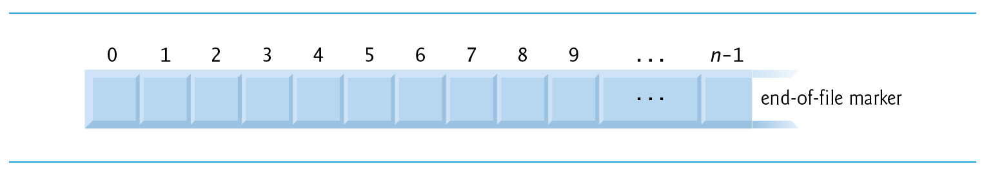
Figure 17.1 C sharp’s View of an n-Byte File

Slide 8
17.2 Files and Streams (2 of 4)
When a console app executes, the runtime environment creates three stream objects that are accessible via properties Console.Out, Console.In and Console.Error, respectively.
These objects use streams to facilitate communication between a program and a particular file or device.
Console.In refers to the standard input stream object, which enables a program to input data from the keyboard.
Console.Out refers to the standard output stream object, which enables a program to output data to the screen.
Console.Error refers to the standard error stream object, which enables a program to output error messages to the screen.

Slide 9
17.2 Files and Streams (3 of 4)
Abstract class Stream provides functionality for representing streams as bytes. Classes FileStream, MemoryStream and BufferedStream (all from namespace System.I O) inherit from class Stream.
Class FileStream can be used to write data to and read data from files.
Class MemoryStream enables the transfer of data directly to and from memory—this is much faster than reading from and writing to external devices.
Class BufferedStream uses buffering to transfer data to or from a stream.

Slide 10
17.2 Files and Streams (4 of 4)
The System.I O namespace includes stream classes such as StreamReader (for text input from a file), StreamWriter (for text output to a file) and FileStream (for both input from and output to a file).
These stream classes inherit from abstract classes TextReader, TextWriter and Stream, respectively.
Properties Console.In and Console.Out are of type TextReader and TextWriter, respectively.
The system creates objects of TextReader and TextWriter derived classes to initialize Console properties Console.In and Console.Out.

Slide 11
17.3 Creating a Sequential-Access Text File (1 of 11)
imposes no structure on files.
Thus, the concept of a “record” does not exist in
files.
This means that you must structure files to meet the requirements of your apps.

Slide 12
17.3 Creating a Sequential-Access Text File (2 of 11)
Class BankU IForm
The following examples demonstrate file processing in a bank-account maintenance app.
These programs have similar user interfaces, so we created reusable class BankU IForm (Figure 17.7 see slide 61) to encapsulate a base-class G U I (see the screen capture in Figure 17.7 see slide 61).

Slide 13
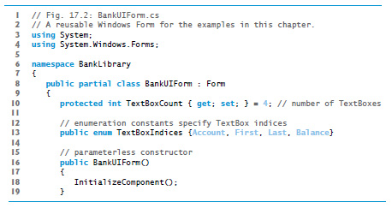
Figure 17.2 A Reusable Windows Form for the Examples in This Chapter (1 of 4)

Slide 14
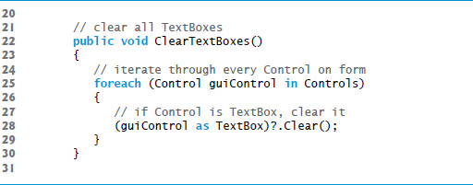
Figure 17.2 A Reusable Windows Form for the Examples in This Chapter (2 of 4)

Slide 15
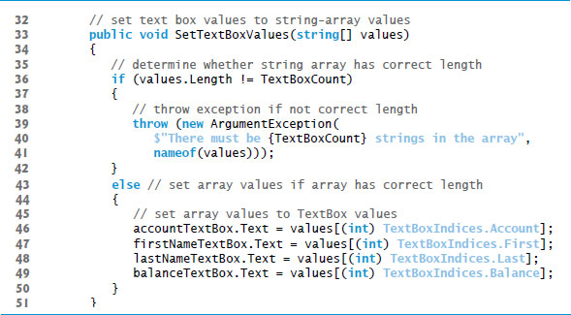
Figure 17.2 A Reusable Windows Form for the Examples in This Chapter (3 of 4)

Slide 16
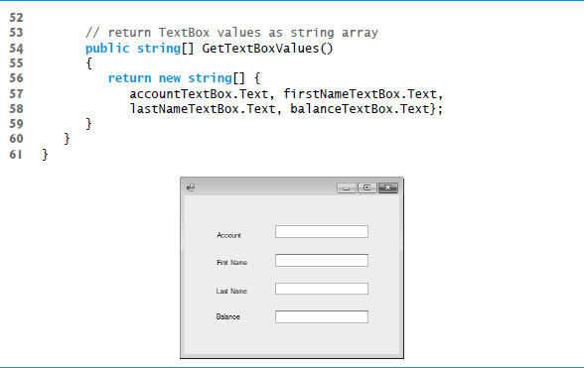
Figure 17.2 A Reusable Windows Form for the Examples in This Chapter (4 of 4)

Slide 17
17.3 Creating a Sequential-Access Text File (3 of 11)
Using visual inheritance (Section 15.13), you can extend this class to create the G U I s for several examples in this chapter.
Recall that to reuse class BankUIForm, you must compile the G U I into a class library, then add a reference to the new class library in each project that will reuse it.
This library (BankLibrary) is provided with the code for this chapter.
You might need to re-add the references to this library in our examples when you copy them to your system, since the library most likely will reside in a different location on your system.

Slide 18
17.3 Creating a Sequential-Access Text File (4 of 11)
Class Record
Figure 17.8 (see slide 79) contains class Record that Figures 17.4 (see slide 23), 17.6 (see slide 43) and 17.7 (see slide 61) use for maintaining the information in each record that’s written to or read from a file.
This class also belongs to the BankLibrary D L L, so it’s located in the same project as class BankU Iform.

Slide 19
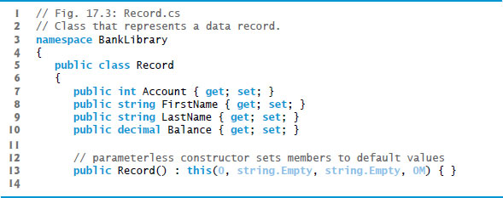
Figure 17.3 Class That Represents a Data Record (1 of 2)

Slide 20
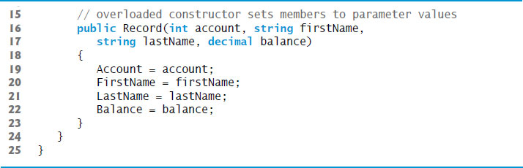
Figure 17.3 Class That Represents a Data Record (2 of 2)

Slide 21
17.3 Creating a Sequential-Access Text File (5 of 11)
Using a Character Stream to Create an Output File
Class CreateFileForm (Figure 17.4 see slide 23) uses instances of class Record to create a sequential-access file that might be used in an accounts-receivable system—i.e., a program that organizes data regarding money owed by a company’s credit clients.
For each client, the program obtains an account number and the client’s first name, last name and balance (i.e., the amount of money that the client owes to the company for previously received goods and services).
The data obtained for each client constitutes a record for that client.

Slide 22
17.3 Creating a Sequential-Access Text File (6 of 11)
In this app, the account number is used as the record key—files are created and maintained in account-number order.
This program assumes that the user enters records in account-number order. However, a comprehensive accounts-receivable system would provide a sorting capability, so the user could enter the records in any order.

Slide 23
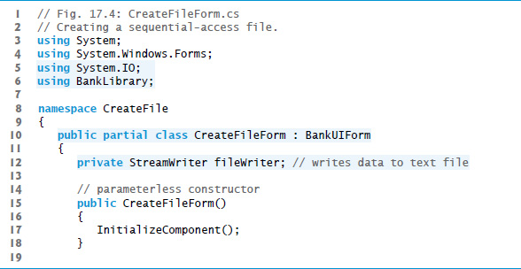
Figure 17.4 Creating a Sequential-Access File (1 of 11)

Slide 24
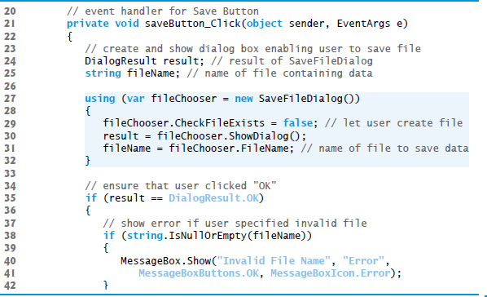
Figure 17.4 Creating a Sequential-Access File (2 of 11)

Slide 25
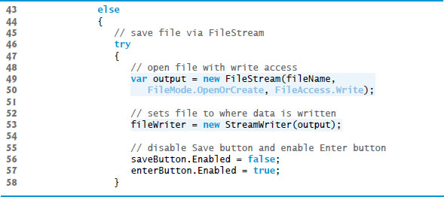
Figure 17.4 Creating a Sequential-Access File (3 of 11)

Slide 26
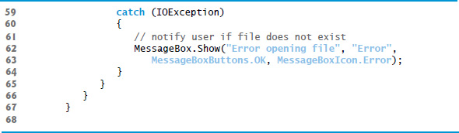
Figure 17.4 Creating a Sequential-Access File (4 of 11)

Slide 27
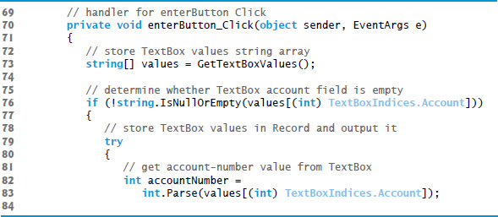
Figure 17.4 Creating a Sequential-Access File (5 of 11)

Slide 28
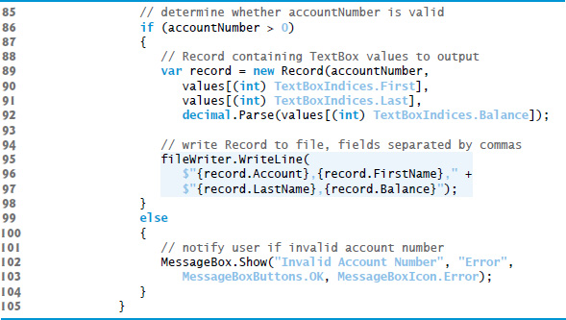
Figure 17.4 Creating a Sequential-Access File (6 of 11)

Slide 29
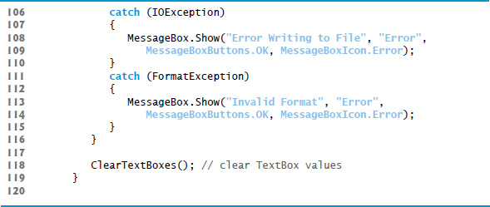
Figure 17.4 Creating a Sequential-Access File (7 of 11)

Slide 30
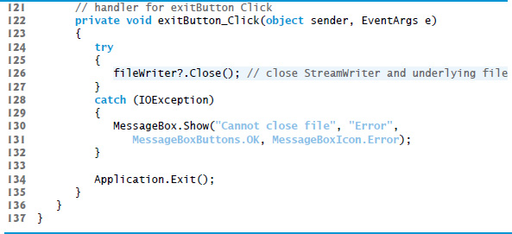
Figure 17.4 Creating a Sequential-Access File (8 of 11)

Slide 31
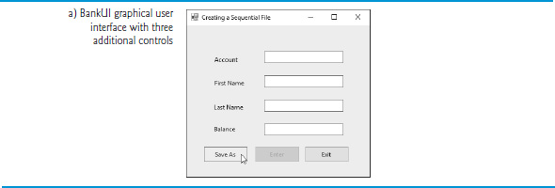
Figure 17.4 Creating a Sequential-Access File (9 of 11)

Slide 32
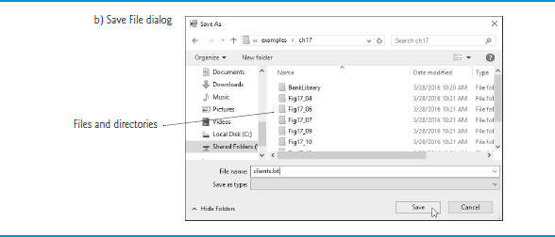
Figure 17.4 Creating a Sequential-Access File (10 of 11)

Slide 33
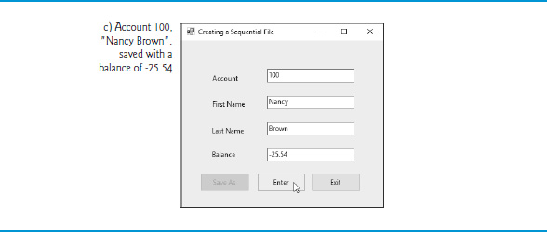
Figure 17.4 Creating a Sequential-Access File (11 of 11)

Slide 34
17.3 Creating a Sequential-Access Text File (7 of 11)
Method saveButton_Click
Line 27 instantiates an object of class SaveFileDialog (namespace System.Windows.Forms).
By placing this object in a using statement (lines 27–32), we can ensure that the dialog’s Dispose method is called to release its resources as soon as the program has retrieved user input from it. SaveFileDialog objects are used for selecting files (see the second screen in Figure 17.4 see slide 23).
Line 29 indicates that the dialog should not check if the file name specified by the user already exists (this is actually the default).

Slide 35
17.3 Creating a Sequential-Access Text File (8 of 11)
When displayed, a SaveFileDialog prevents the user from interacting with any other window in the program until the user closes the SaveFileDialog by clicking either Save or Cancel.
Dialogs that behave in this manner are called modal dialogs.
The user selects the appropriate drive, directory and file name, then clicks Save.
Method ShowDialog returns a DialogResult specifying which button (Save or Cancel) the user clicked to close the dialog.

Slide 36
Common Programming Error 17.1
Failure to open a file before attempting to use it in a program is a logic error.

Slide 37
17.3 Creating a Sequential-Access Text File (9 of 11)
Method enterButton_Click
After typing information into each TextBox, the user clicks Enter, which calls enterButton_Click (lines 70–119) to save the data from the TextBoxes into the user-specified file.
If the user entered a valid account number, lines 89–92 create a Record containing the TextBox values.
If the user entered invalid data, the program throws a FormatException.
Lines 95–97 write the record to the file by invoking method WriteLine of the StreamWriter object that was created at line 53.

Slide 38
17.3 Creating a Sequential-Access Text File (10 of 11)
Method exitButton_Click
When the user clicks Exit, exitButton_Click (lines 122–135) executes.
Line 126 closes the StreamWriter, which automatically closes the FileStream.
Then, line 134 terminates the program.
Note that method Close is called in a try block.
Method Close throws an I O Exception if the file or stream cannot be closed properly.
In this case, it’s important to notify the user that the information in the file or stream might be corrupted.

Slide 39
Performance Tip 17.1
Releasing resources explicitly when they’re no longer needed makes them immediately available for reuse by other programs, thus improving resource utilization.

Slide 40
17.3 Creating a Sequential-Access Text File (11 of 11)
Sample Data
To test the program, we entered information for the accounts shown in Figure 17.5.
The program does not depict how the data records are stored in the file.
To verify that the file has been created successfully, we create a program in the next section to read and display the file.
Since this is a text file, you can actually open it in any text editor to see its contents.

Slide 41
Figure 17.5 Sample Data for the Program of Figure 17.4
Account number | First name | Last name | Balance
100 | Nancy | Brown | −25.54
200 | Stacey | Dunn | 314.33
300 | Doug | Barker | 0.00
400 | Dave | Smith | 258.34
500 | Sam | Stone | 34.98

Slide 42
17.4 Reading Data from a Sequential-Access Text File (1 of 6)
Class ReadSequentialAccessFileForm (Figure 17.6) reads records from the file created by the program in Figure 17.4 (see slide 23), then displays the contents of each record.
Much of the code in this example is similar to that of Figure 17.4 (see slide 23), so we discuss only the unique aspects of the app.

Slide 43
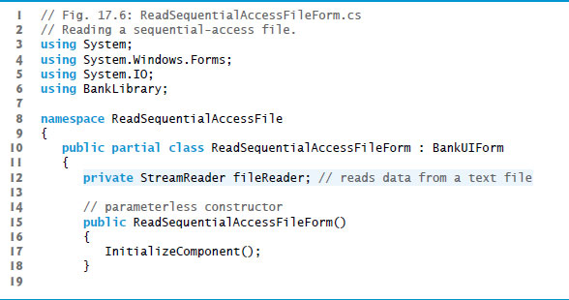
Figure 17.6 Reading a Sequential-Access File (1 of 8)

Slide 44
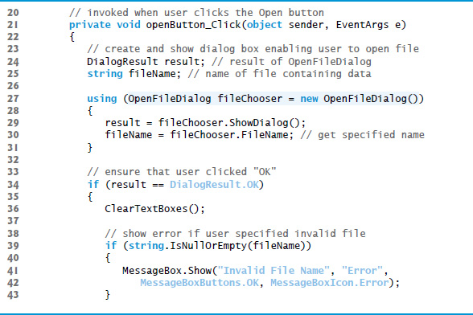
Figure 17.6 Reading a Sequential-Access File (2 of 8)

Slide 45
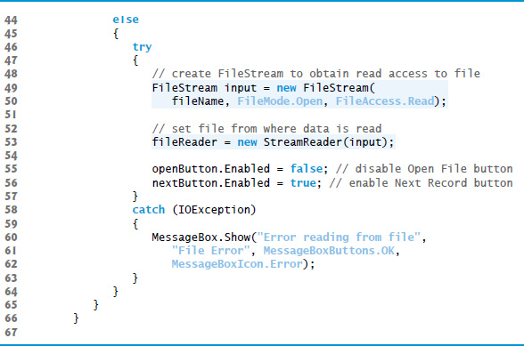
Figure 17.6 Reading a Sequential-Access File (3 of 8)

Slide 46
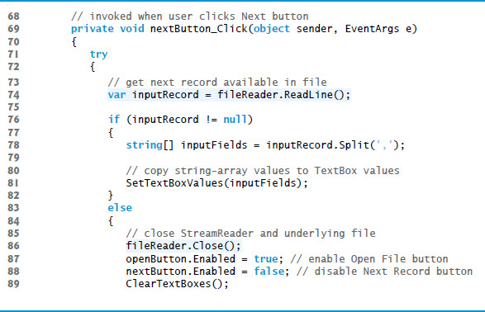
Figure 17.6 Reading a Sequential-Access File (4 of 8)

Slide 47
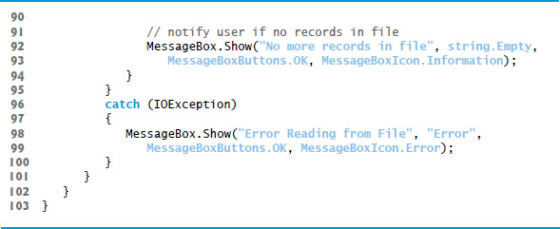
Figure 17.6 Reading a Sequential-Access File (5 of 8)

Slide 48
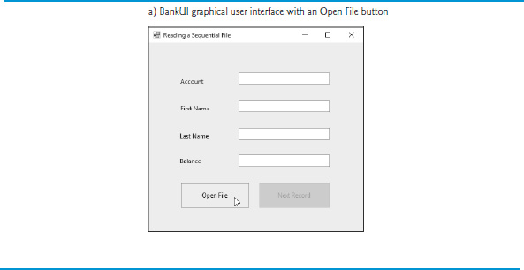
Figure 17.6 Reading a Sequential-Access File (6 of 8)

Slide 49
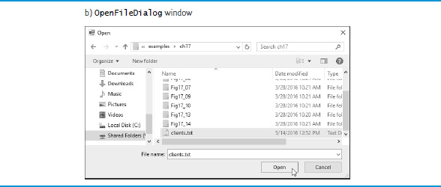
Figure 17.6 Reading a Sequential-Access File (7 of 8)

Slide 50
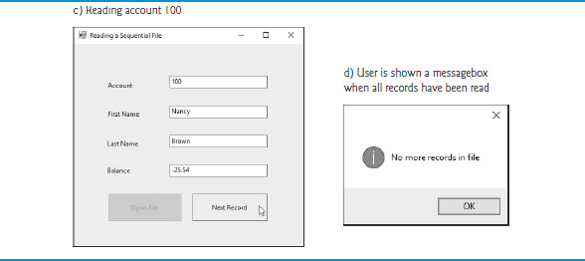
Figure 17.6 Reading a Sequential-Access File (8 of 8)

Slide 51
17.4 Reading Data from a Sequential-Access Text File (2 of 6)
Method openButton_Click
When the user clicks Open File, the program calls event handler openButton_Click.
Line 27 creates an OpenFileDialog, and line 29 calls its ShowDialog method to display the Open dialog.
The behavior and G U I for the Save and Open dialog types are identical, except that Save is replaced by Open.
If the user selects a valid file name, lines 49–50 create a FileStream object and assign it to reference input.

Slide 52
17.4 Reading Data from a Sequential-Access Text File (3 of 6)
We pass constant FileMode.Open as the second argument to the FileStream constructor to indicate that the FileStream should open the file if it exists or throw a FileNotFoundException if it does not. (In this example, the FileStream constructor will not throw a FileNotFoundException, because the OpenFileDialog is configured to check that the file exists.)
In the last example (Figure 17.9 see slide 84), we wrote text to the file using a FileStream object with write-only access.

Slide 53
17.4 Reading Data from a Sequential-Access Text File (4 of 6)
In this example, we specify read-only access to the file by passing constant FileAccess.Read as the third argument to the FileStream constructor.
This FileStream object is used to create a StreamReader object.
The FileStream object specifies the file from which the StreamReader object will read text.

Slide 54
Error-Prevention Tip 17.1
Open a file with the FileAccess.Read file-open mode if its contents should not be modified. This prevents unintentional modification of the contents.

Slide 55
17.4 Reading Data from a Sequential-Access Text File (5 of 6)
Method nextButton_Click
When the user clicks the Next Record button, the program calls event handler nextButton_Click, which reads the next record from the user-specified file.
The user must click Next Record after opening the file to view the first record.
Line 74 calls StreamReader method ReadLine to read the next record.
If an error occurs while reading the file, an I OException is thrown and the user is notified.

Slide 56
17.4 Reading Data from a Sequential-Access Text File (6 of 6)
Otherwise, line 76 determines whether StreamReader method ReadLine returned null (i.e., there’s no more text in the file).
If not, method Split of class string separates the stream of characters that was read from the file into tokens (strings) that represent the Record’s properties—the second argument indicates that the tokens are delimited by commas in this file.
If ReadLine returns null, the program closes the StreamReader object, automatically closing the FileStream object, then notifies the user that there are no more records.

Slide 57
17.5 Case Study: Credit Inquiry Program (1 of 4)
To retrieve data sequentially from a file, programs normally start from the beginning of the file, reading consecutively until the desired data is found.
It sometimes is necessary to process a file sequentially several times (from the beginning of the file) during the execution of a program.
A FileStream object can reposition its file-position pointer (which contains the byte number of the next byte to be read from or written to the file) to any position in the file.
When a FileStream object is opened, its file-position pointer is set to byte position 0 (i.e., the beginning of the file)

Slide 58
17.5 Case Study: Credit Inquiry Program (2 of 4)
Class CreditInquiryForm (Figure 17.7 see slide 61) is a credit-inquiry program that enables a credit manager to search for and display account information for those customers with credit balances (i.e., customers to whom the company owes money), zero balances (i.e., customers who do not owe the company money) and debit balances (i.e., customers who owe the company money for previously received goods and services).

Slide 59
17.5 Case Study: Credit Inquiry Program (3 of 4)
We use a RichTextBox in the program to display the account information.
RichTextBoxes provide more functionality than regular TextBoxes
for example, RichTextBoxes offer method Find for searching individual strings and method LoadFile for displaying file contents.
Classes RichTextBox and TextBox both inherit from abstract class System.Windows.Forms.TextBoxBase.
In this example, we chose a RichTextBox, because it displays multiple lines of text by default, whereas a regular TextBox displays only one.
We could have specified that a TextBox object display multiple lines of text by setting its Multiline property to true.

Slide 60
17.5 Case Study: Credit Inquiry Program (4 of 4)
The program displays buttons that enable a credit manager to obtain credit information.
The Open File button opens a file for gathering data.
The Credit Balances button displays a list of accounts that have credit balances, the Debit Balances button displays a list of accounts that have debit balances and the Zero Balances button displays a list of accounts that have zero balances.
The Done button exits the app.

Slide 61
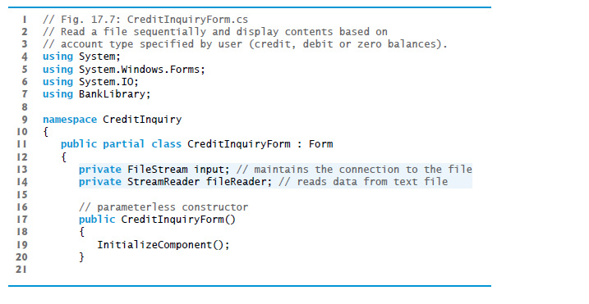
Figure 17.7 Credit-Inquiry Program (1 of 11)

Slide 62
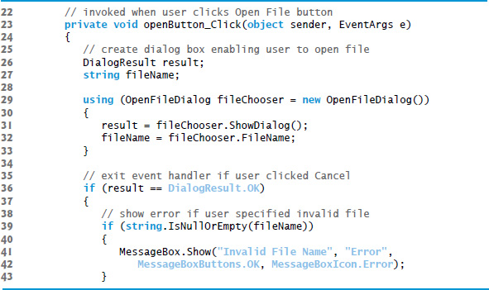
Figure 17.7 Credit-Inquiry Program (2 of 11)

Slide 63
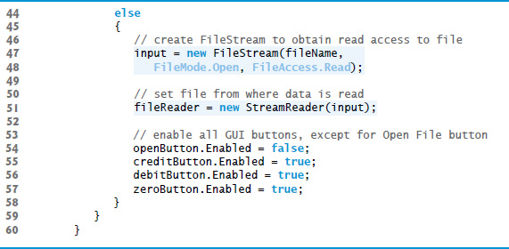
Figure 17.7 Credit-Inquiry Program (3 of 11)

Slide 64
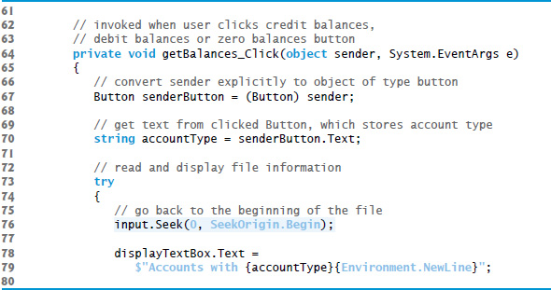
Figure 17.7 Credit-Inquiry Program (4 of 11)

Slide 65
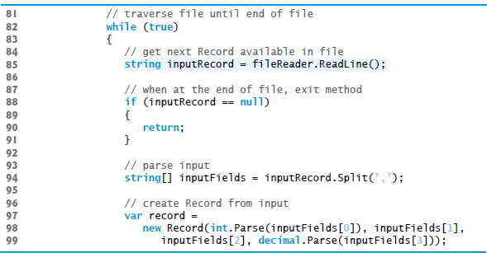
Figure 17.7 Credit-Inquiry Program (5 of 11)

Slide 66
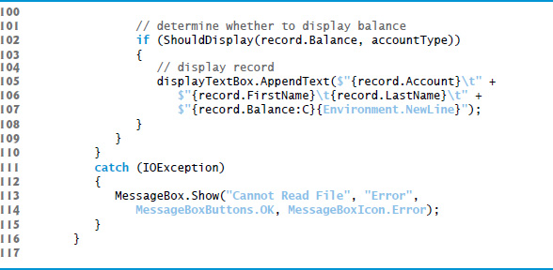
Figure 17.7 Credit-Inquiry Program (6 of 11)

Slide 67
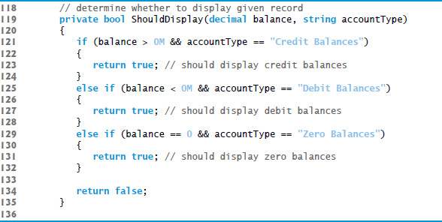
Figure 17.7 Credit-Inquiry Program (7 of 11)

Slide 68
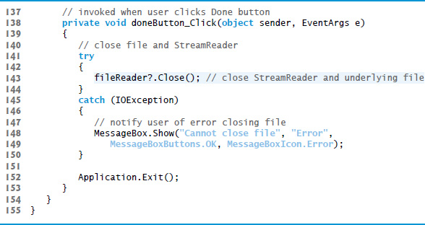
Figure 17.7 Credit-Inquiry Program (8 of 11)

Slide 69
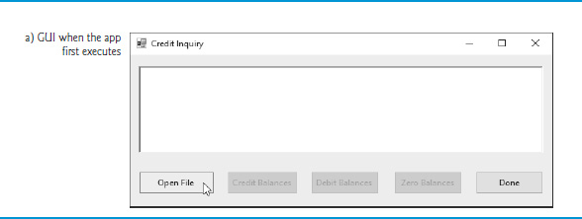
Figure 17.7 Credit-Inquiry Program (9 of 11)

Slide 70
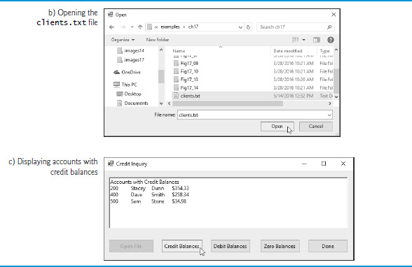
Figure 17.7 Credit-Inquiry Program (10 of 11)

Slide 71
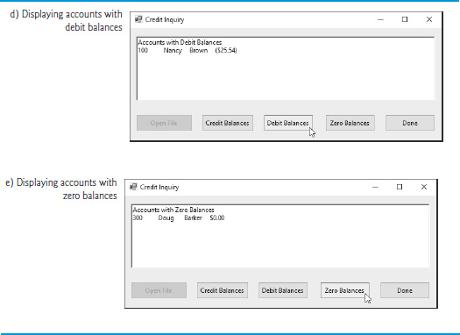
Figure 17.7 Credit-Inquiry Program (11 of 11)

Slide 72
17.6 Serialization (1 of 5)
In the prior examples, Record was used to aggregate the information for one record.
When the instance variables for a Record were output to a disk file, certain information was lost, such as the type of each value.
For instance, if the value "3" is read from a file, there’s no way to tell if the value came from an int, a string or a decimal.

Slide 73
17.6 Serialization (2 of 5)
We have only data, not type information, on disk.
If the program that’s going to read this data “knows” what object type the data corresponds to, then the data can be read directly into objects of that type.
For example, in Figure 17.11 (see slide 99), we know that we are inputting an int (the account number), the first and last name strings and a decimal (the balance).
We also know that these values are separated by commas, with only one record on each line.
So, we are able to parse the strings and convert the account number to an int and the balance to a decimal.

Slide 74
17.6 Serialization (3 of 5)
Sometimes it would be easier to read or write entire objects.
provides such a mechanism, called object serialization.
A serialized object is an object represented as a sequence of bytes that includes the object’s data, as well as information about the object’s type and the types of data stored in the object.
After a serialized object has been written to a file, it can be read from the file and deserialized—that is, the type information and bytes that represent the object and its data can be used to recreate the object in memory.

Slide 75
17.6 Serialization (4 of 5)
Class BinaryFormatter (namespace System.Runtime.Serialization.Formatters.Binary) enables entire objects to be written to or read from a stream.
BinaryFormatter method Serialize writes an object’s representation to a file.
BinaryFormatter method Deserialize reads this representation from a file and reconstructs the original object.
Both methods throw a SerializationException if an error occurs during serialization or deserialization.
Both methods require a Stream object (e.g., the FileStream) as a parameter so that the BinaryFormatter can access the correct stream.

Slide 76
17.6 Serialization (5 of 5)
Next, we create and manipulate sequential-access files using object serialization.
Object serialization is performed with byte-based streams, so the sequential files created and manipulated will be binary files.
Binary files are not human readable.
For this reason, we write a separate app that reads and displays serialized objects.

Slide 77
17.7 Creating a Sequential-Access File Using Object Serialization (1 of 5)
We begin by creating and writing serialized objects to a sequential-access file.
In this section, we reuse much of the code from earlier sections, so we focus only on the new features.

Slide 78
17.7 Creating a Sequential-Access File Using Object Serialization (2 of 5)
Defining the RecordSerializable Class
Class RecordSerializable (Figure 17.8 (see slide 79; part of the BankLibrary project) is marked with the [Serializable] attribute (line 7), which indicates to the C L R that RecordSerializable objects can be serialized.
Classes that represent serializable types must include this attribute in their declarations or must implement interface I Serializable.

Slide 79
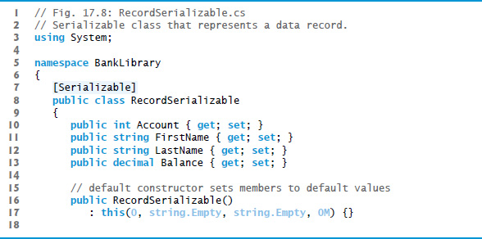
Figure 17.8 Serializable Class That Represents a Data Record (1 of 2)

Slide 80
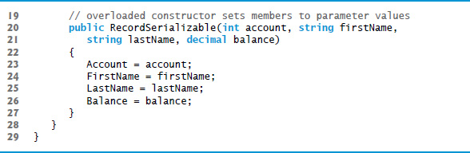
Figure 17.8 Serializable Class That Represents a Data Record (2 of 2)

Slide 81
17.7 Creating a Sequential-Access File Using Object Serialization (3 of 5)
In a class that’s marked with the [Serializable] attribute or that implements interface ISerializable, you must ensure that every instance variable of the class is also serializable.
All simple-type variables and strings are serializable.
For variables of reference types, you must check the class declaration (and possibly its base classes) to ensure that the type is serializable.
By default, array objects are serializable.
However, if the array contains references to other objects, those objects may or may not be serializable.

Slide 82
17.7 Creating a Sequential-Access File Using Object Serialization (4 of 5)
Using a Serialization Stream to Create an Output File
Next, we’ll create a sequential-access file with serialization (Figure 17.9 see slide 84).
To test this program, we used the sample data from Figure 17.5 (see slide 41) to create a file named clients.ser.
Line 15 creates a BinaryFormatter for writing serialized objects.
Lines 55–56 open the FileStream to which this program writes the serialized objects.
The string argument that’s passed to the FileStream’s constructor represents the name and path of the file to be opened.
This specifies the file to which the serialized objects will be written.

Slide 83
17.7 Creating a Sequential-Access File Using Object Serialization (5 of 5)
The program does not show how the data records actually appear in the file.
Remember that we are now using binary files, which are not human readable.
To verify that the file was created successfully, the next section presents a program to read the file’s contents.

Slide 84
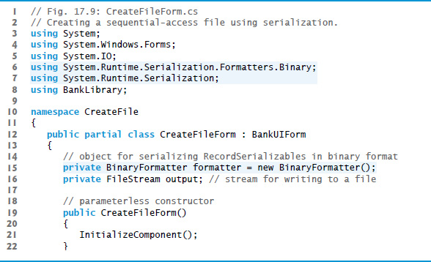
Figure 17.9 Creating a Sequential-Access File Using Serialization (1 of 7)

Slide 85
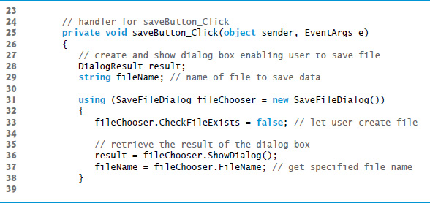
Figure 17.9 Creating a Sequential-Access File Using Serialization (2 of 7)

Slide 86
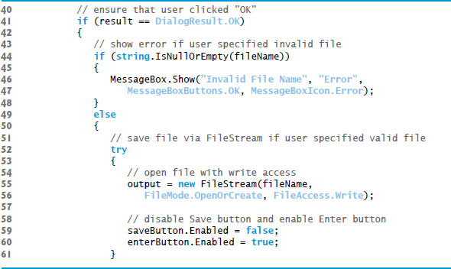
Figure 17.9 Creating a Sequential-Access File Using Serialization (3 of 7)

Slide 87
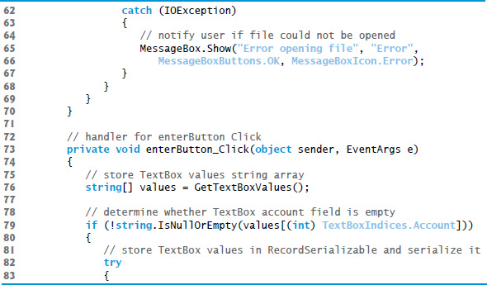
Figure 17.9 Creating a Sequential-Access File Using Serialization (4 of 7)

Slide 88
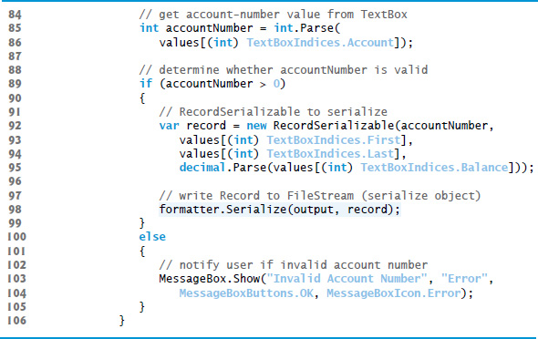
Figure 17.9 Creating a Sequential-Access File Using Serialization (5 of 7)

Slide 89
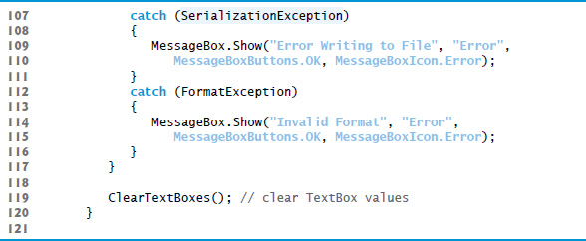
Figure 17.9 Creating a Sequential-Access File Using Serialization (6 of 7)

Slide 90
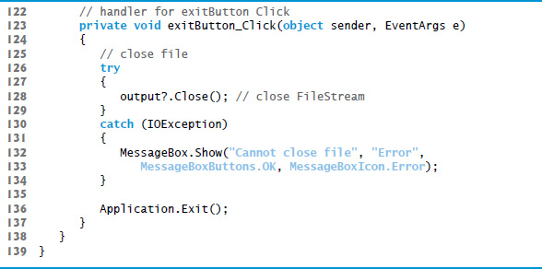
Figure 17.9 Creating a Sequential-Access File Using Serialization (7 of 7)

Slide 91
17.8 Reading and Deserializing Data from a Binary File (1 of 2)
The preceding section showed how to create a sequential-access file using object serialization.
In this section, we discuss how to read serialized objects sequentially from a file.
Figure 17.10 (see slide 93) reads and displays the contents of the clients.ser file created by the program in Figure 17.9 (see slide 84).

Slide 92
17.8 Reading and Deserializing Data from a Binary File (2 of 2)
The program reads objects from a file in event handler nextButton_Click.
We use method Deserialize to read the data.
Note that we cast the result of Deserialize to type RecordSerializable—this cast is necessary, because Deserialize returns a reference of type object and we need to access properties that belong to class RecordSerializable.
If an error occurs during deserialization or the end of the file is reached, a SerializationException is thrown, and the FileStream object is closed.

Slide 93
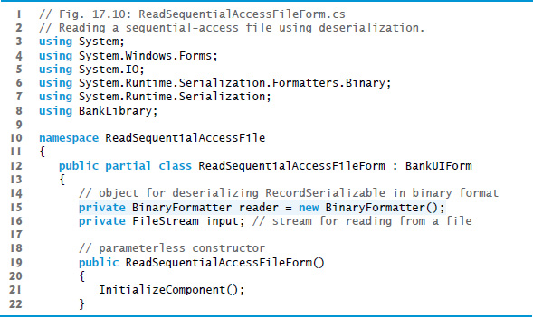
Figure 17.10 Reading a Sequential-Access File Using Deserialization (1 of 5)

Slide 94
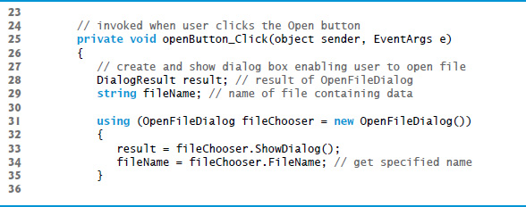
Figure 17.10 Reading a Sequential-Access File Using Deserialization (2 of 5)

Slide 95
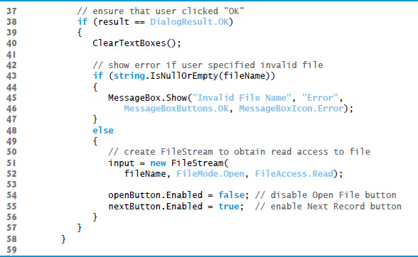
Figure 17.10 Reading a Sequential-Access File Using Deserialization (3 of 5)

Slide 96

Figure 17.10 Reading a Sequential-Access File Using Deserialization (4 of 5)

Slide 97

Figure 17.10 Reading a Sequential-Access File Using Deserialization (5 of 5)

Slide 98
17.9 Classes File and Directory (1 of 5)
Information is stored in files, which are organized in directories (also called folders).
Classes File and Directory enable programs to manipulate files and directories on disk.
Class File can determine information about files and can be used to open files for reading or writing.
Figure 17.11 lists several of class File’s static methods for manipulating and determining information about files.

Slide 99
Figure 17.11 File Class Static Methods (Partial List) (1 of 2)
static Method | Description
AppendText | Returns a StreamWriter that appends text to an existing file or creates a file if one does not exist.
Copy | Copies a file to a new file.
Create | Creates a file and returns its associated FileStream.
CreateText | Creates a text file and returns its associated StreamWriter.
Delete | Deletes the specified file.
Exists | Returns true if the specified file exists and false otherwise.
GetCreationTime | Returns a DateTime object representing when the file/directory was created.

Slide 100
Figure 17.11 File Class Static Methods (Partial List) (2 of 2)
static Method | Description
GetLastAccessTime | Returns a DateTime object representing when the file/directory was last accessed.
GetLastWriteTime | Returns a DateTime object representing when the file/directory was last modified.
Move | Moves the specified file to a specified location.
Open | Returns a FileStream associated with the specified file and equipped with the specified read/write permissions.
OpenRead | Returns a read-only FileStream associated with the specified file.
OpenText | Returns a StreamReader associated with the specified file.
OpenWrite | Returns a write FileStream associated with the specified file.

Slide 101
17.9 Classes File and Directory (2 of 5)
Class Directory provides capabilities for manipulating directories.
Figure 17.12 lists some of class Directory’s static methods for directory manipulation.
The DirectoryInfo object returned by method CreateDirectory contains information about a directory.
Much of the information contained in class DirectoryInfo also can be accessed via the methods of class Directory.

Slide 102
Figure 17.12 Directory Class Static Methods (1 of 2)
Static Method | Description
CreateDirectory | Creates a directory and returns its associated DirectoryInfo object.
Delete | Deletes the specified directory.
Exists | Returns true if the specified directory exists and false otherwise.
GetDirectories | Returns a string array containing the names of the subdirectories in the specified directory.
GetFiles | Returns a string array containing the names of the files in the specified directory.
GetCreationTime | Returns a DateTime object representing when the directory was created.

Slide 103
Figure 17.12 Directory Class Static Methods (2 of 2)
Static Method | Description
GetLastAccessTime | Returns a DateTime object representing when the directory was last accessed.
GetLastWriteTime | Returns a DateTime object representing when items were last written to the directory.
Move | Moves the specified directory to a specified location.

Slide 104
17.9 Classes File and Directory (3 of 5)
Demonstrating Classes File and Directory
Class FileTestForm (Figure 17.13) uses File and Directory methods to access file and directory information.

Slide 105

Figure 17.13 Using Classes File and Directory (1 of 8)

Slide 106

Figure 17.13 Using Classes File and Directory (2 of 8)

Slide 107

Figure 17.13 Using Classes File and Directory (3 of 8)

Slide 108

Figure 17.13 Using Classes File and Directory (4 of 8)

Slide 109

Figure 17.13 Using Classes File and Directory (5 of 8)

Slide 110

Figure 17.13 Using Classes File and Directory (6 of 8)

Slide 111

Figure 17.13 Using Classes File and Directory (7 of 8)

Slide 112

Figure 17.13 Using Classes File and Directory (8 of 8)

Slide 113
17.9 Classes File and Directory (4 of 5)
Searching Directories with L I N Q
We now consider another example that uses file- and directory-manipulation capabilities.
Class L I N Q ToFileDirectoryForm (Figure 17.14 see slide 115) uses L I N Q with classes File, Path and Directory to report the number of files of each file type that exist in the specified directory path.

Slide 114
17.9 Classes File and Directory (5 of 5)
The program also serves as a “clean-up” utility—when it finds a file that has the .bak file-name extension (i.e., a backup file), the program displays a MessageBox asking the user whether that file should be removed, then responds appropriately to the user’s input.
This example also uses L I N Q to Objects to help delete the backup files.

Slide 115

Figure 17.14 Using L I N Q to Search Directories and Determine File Types (1 of 9)

Slide 116

Figure 17.14 Using L I N Q to Search Directories and Determine File Types (2 of 9)

Slide 117

Figure 17.14 Using L I N Q to Search Directories and Determine File Types (3 of 9)

Slide 118

Figure 17.14 Using L I N Q to Search Directories and Determine File Types (4 of 9)

Slide 119

Figure 17.14 Using L I N Q to Search Directories and Determine File Types (5 of 9)

Slide 120

Figure 17.14 Using L I N Q to Search Directories and Determine File Types (6 of 9)

Slide 121

Figure 17.14 Using L I N Q to Search Directories and Determine File Types (7 of 9)

Slide 122

Figure 17.14 Using L I N Q to Search Directories and Determine File Types (8 of 9)

Slide 123

Figure 17.14 Using L I N Q to Search Directories and Determine File Types (9 of 9)

Slide 124

Copyright

